Slide 1

Exploring the Atmosphere with Extreme Balloons
Columbia Space Initiative

Slide 2
What is the Columbia Space Initiative?

Slide 3
Workshop Overview
The Ozone Layer
Weather Balloons
The Experiment
Q&A

Slide 4
The Ozone Layer

Slide 5
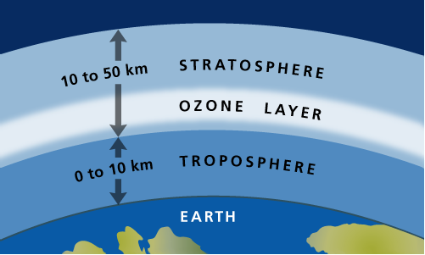
What is the ozone layer?
A layer of ozone (O₃) in the Stratosphere
20 to 30 kilometers (12 to 19 miles) above the Earth
Not very thick - 10ppm (parts per million) compared to 0.3ppm near the surface

Slide 6
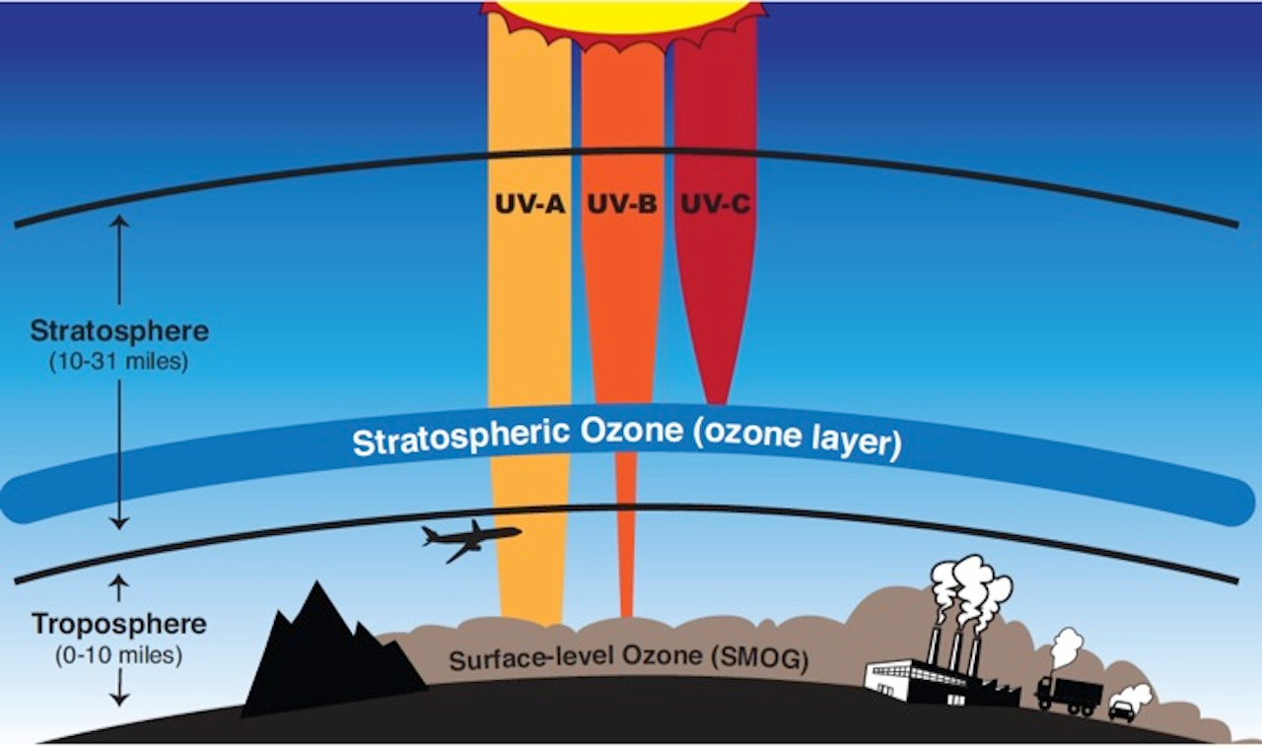
Why is the ozone important to the Earth?
It’s a very thin layer of gas very high up - why is it important?
It’s important because it absorbs harmful radiation from the sun.
The Ozone layer blocks 98% of UVB, or Ultraviolet-B, radiation from the sun.
The Ozone layer also blocks 100% of UVC radiation.
UVB is harmful to life on Earth.
UVB is linked to skin cancer and cataracts in humans
UVB leads to damage to oceanic life.
UVB also impairs photosynthesis in plants.

Slide 7
The ozone layer is extremely important to life on Earth.

Slide 8
What happened to the ozone layer?
Beginning in the 1970s, the ozone layer began to be significantly affected by CFCs.
CFCs, or Chlorofluorocarbons, were used in aerosol cans.
Chlorine reacts with ozone and destroys it.
By the late 1980s, the ozone layer above the arctic was destroyed by up to 65 percent.
The Montreal Protocol was signed in 1989 to limit the use of CFCs.
It will still take ~50 years for the ozone layer to recover.

Slide 9
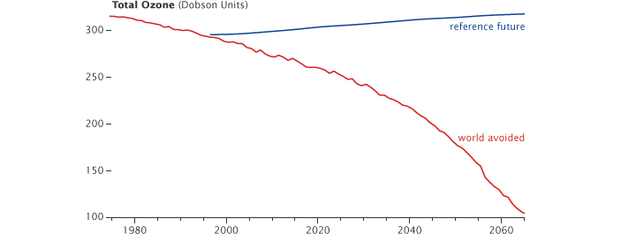
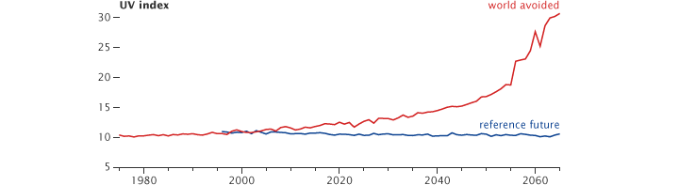
The world we avoided

Slide 10
Weather Balloons

Slide 11
What is a weather balloon?
A weather balloon is a large balloon made to reach high altitudes.
It is often filled with helium or hydrogen.
It can reach 120,000 ft (23 miles, 37 km) or even higher.
The balloon expands to be very large as it rises.
It has a lot of applications:
Weather research: NOAA
Hobbyist: Cameras
Special: Red bull

Slide 12
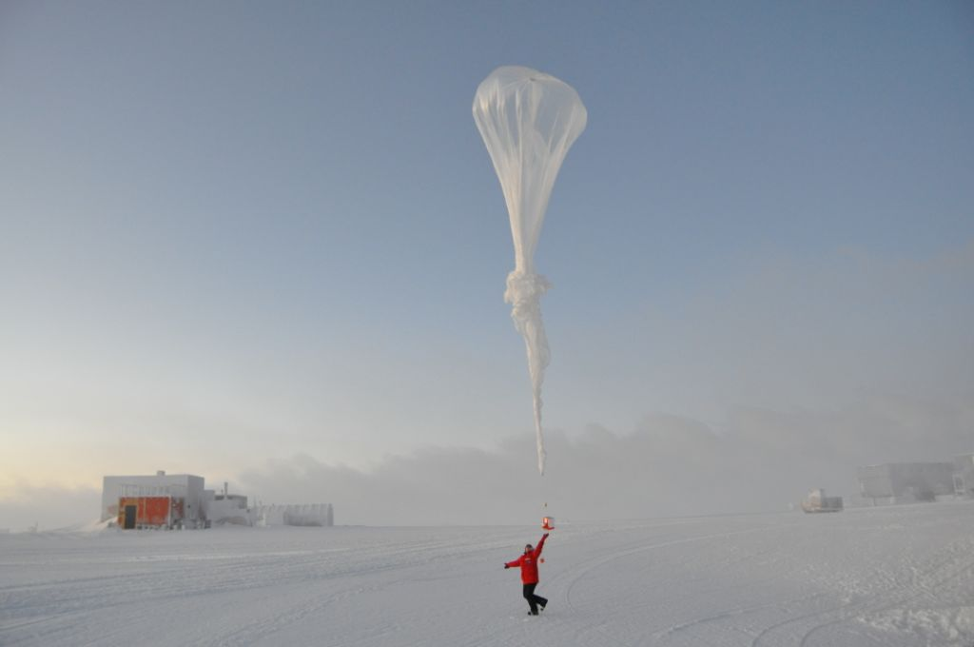
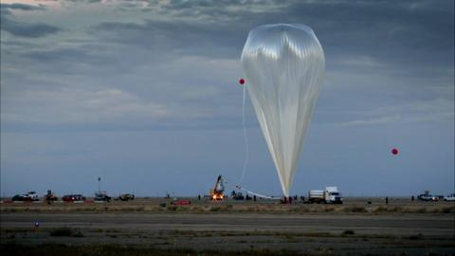
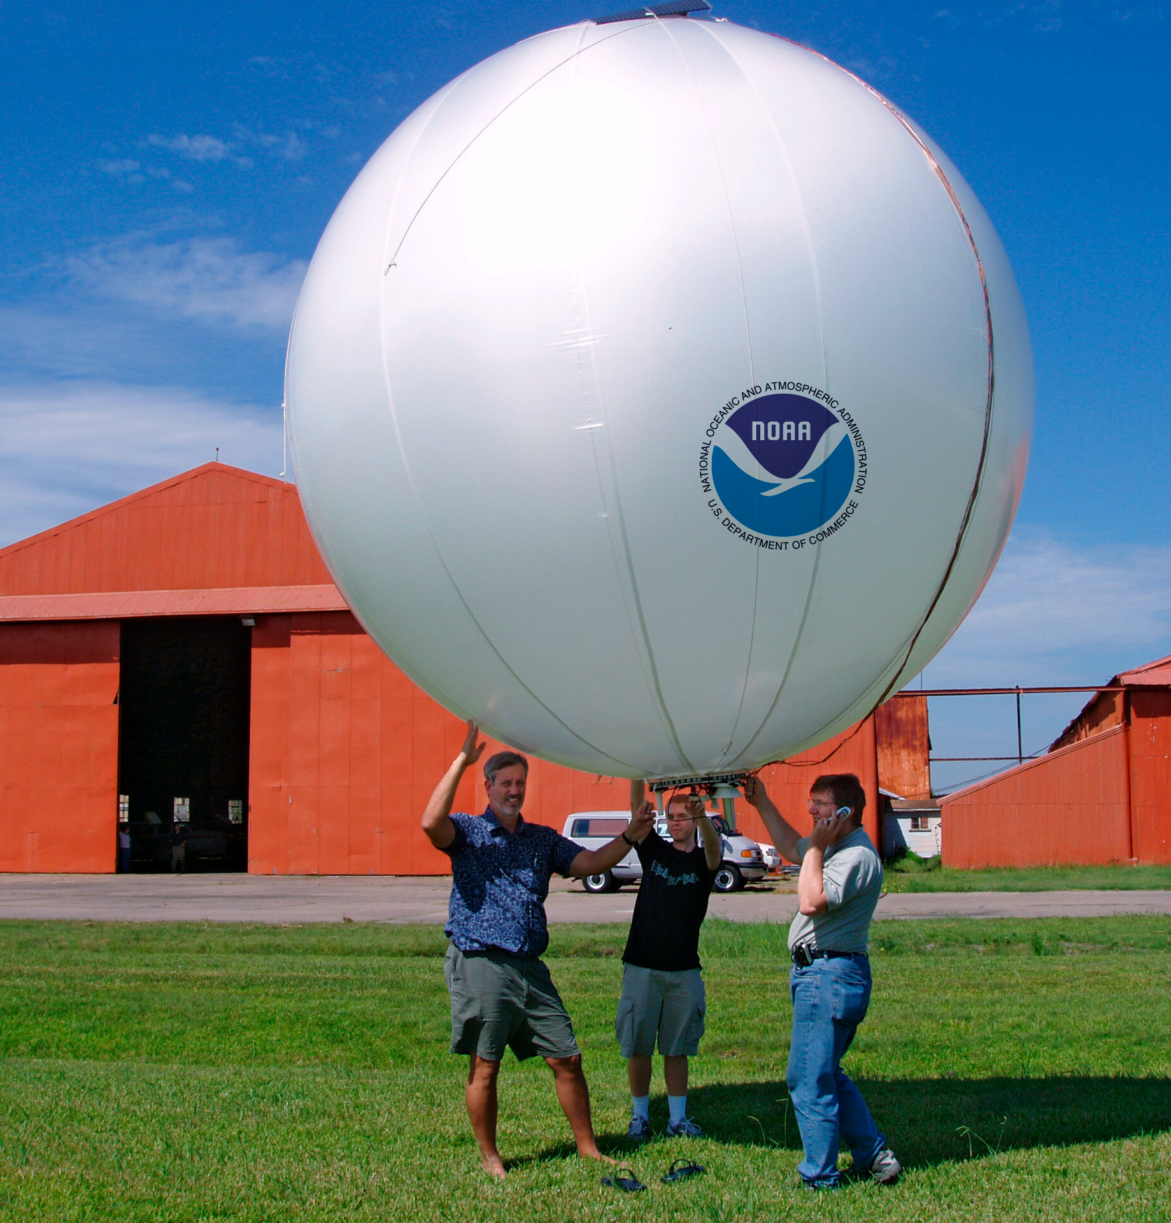
Weather balloons

Slide 13
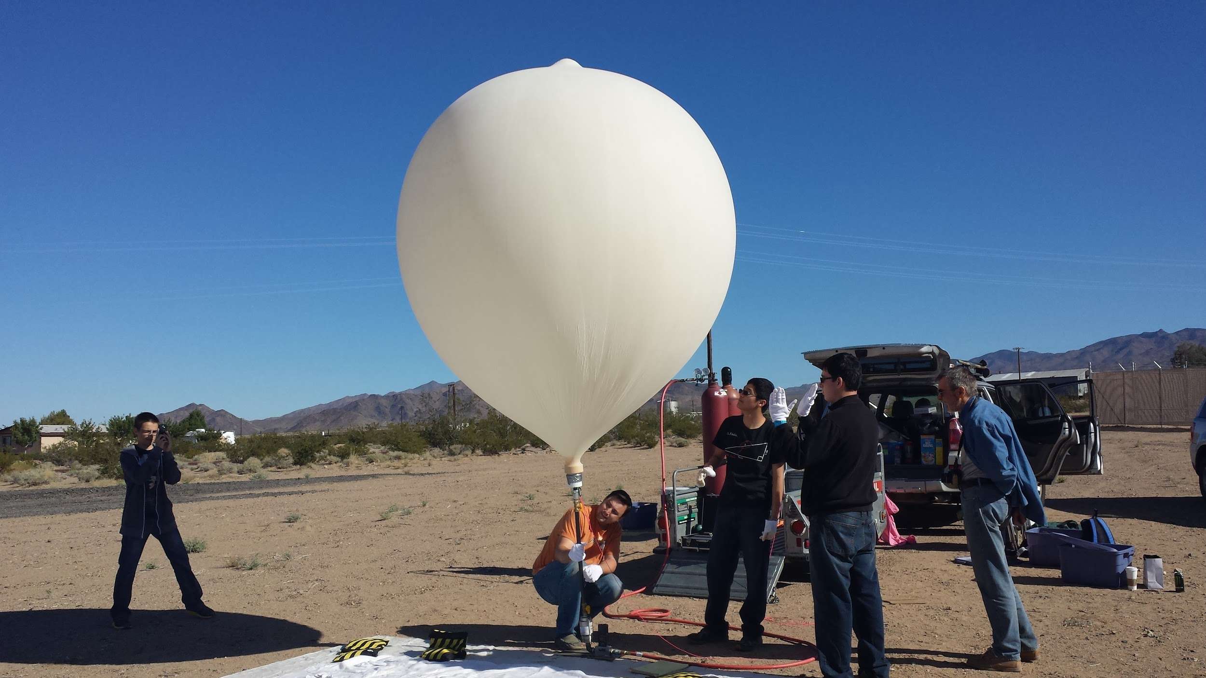
Weather balloons

Slide 14
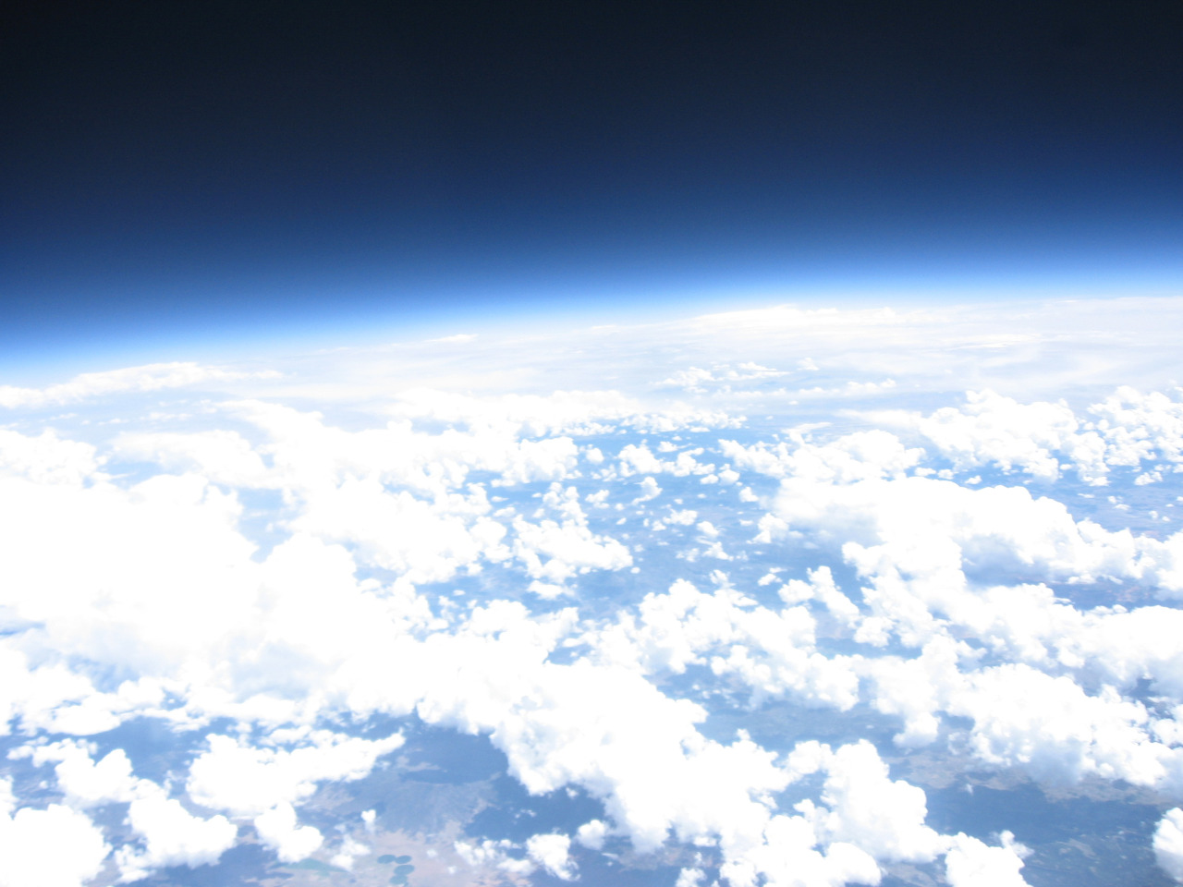
Captured

Slide 15
Gator in space

Slide 16
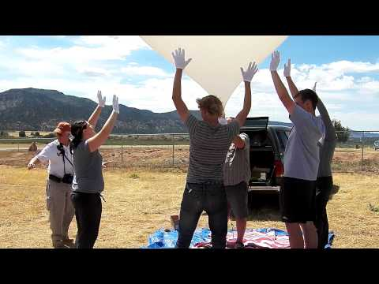
3:30

Slide 17
The Experiment
(The Scientific Method)

Slide 18
The Question
How does the amount of UVB radiation change as we go higher in altitude?
What are we looking for?
What do we want to know?

Slide 19
The Hypothesis
What do we think will happen?
What is our educated guess?
IF-THEN statement

Slide 20
The Experiment
Materials
Logistics
Independent variable
Dependent variable
Procedure
Data
Design and plan the experiment

Slide 21
Analysis
Interpret the data
What does the data mean?

Slide 22
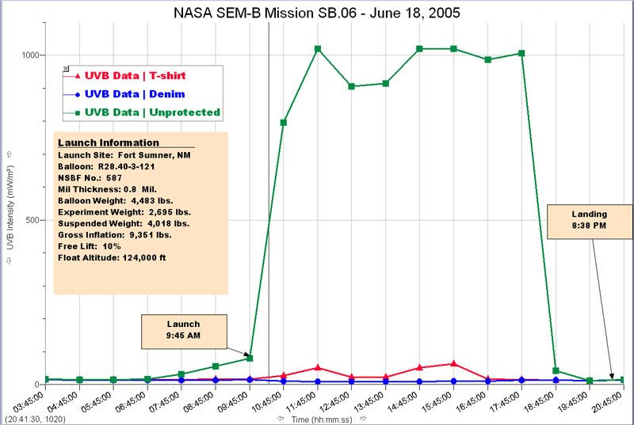
UVB plot

Slide 23
Conclusion
What did we learn?
Do we accept or reject the hypothesis?

Slide 24
Q&A

